Slide 1
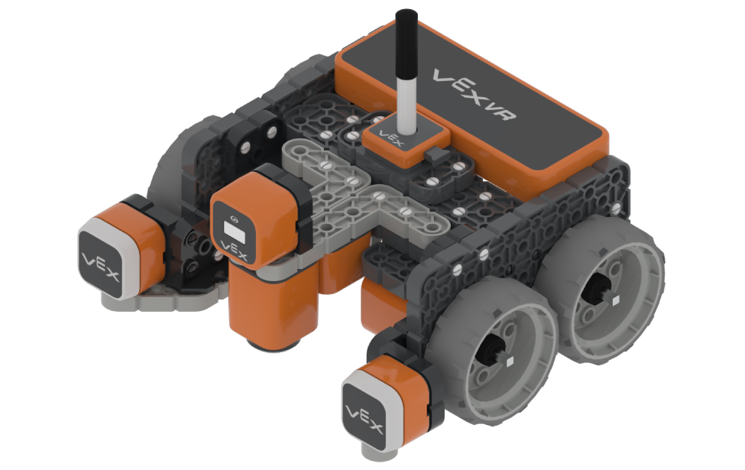
SPIRAL
http://vr.vex.com

Slide 2
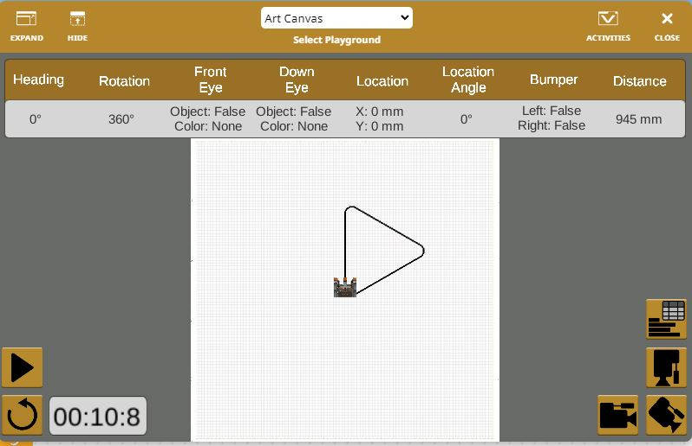
Spiral Level 1

Slide 3
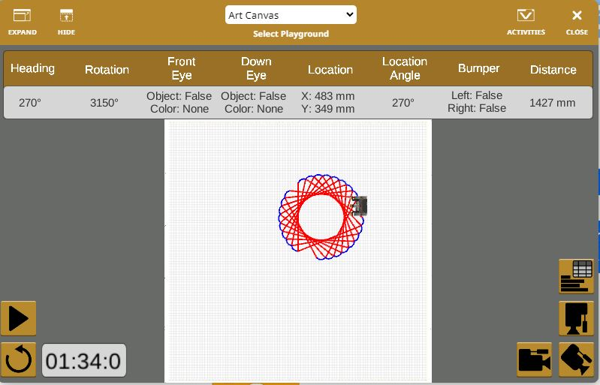
Spiral Roda

Slide 4
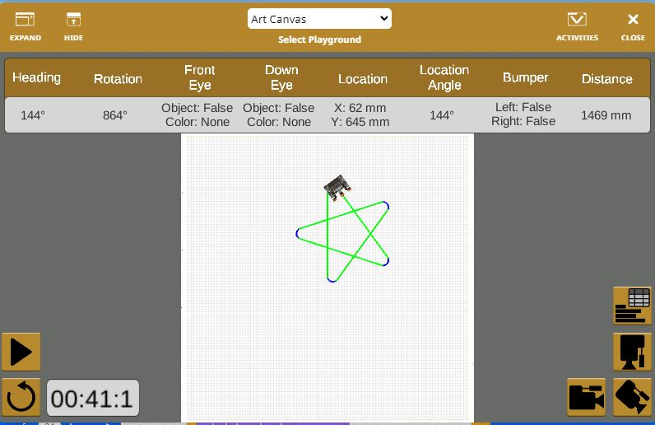
Bintang

Slide 5
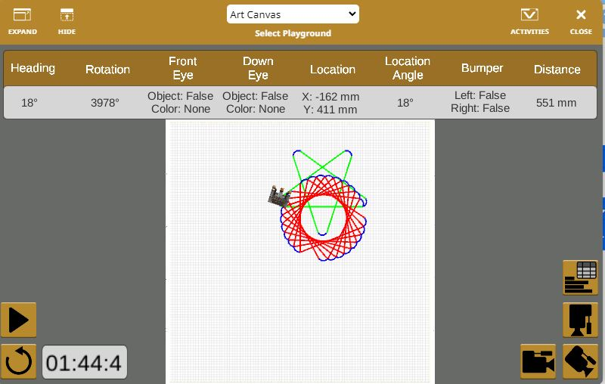
Spiral Level 2

